Slide 1
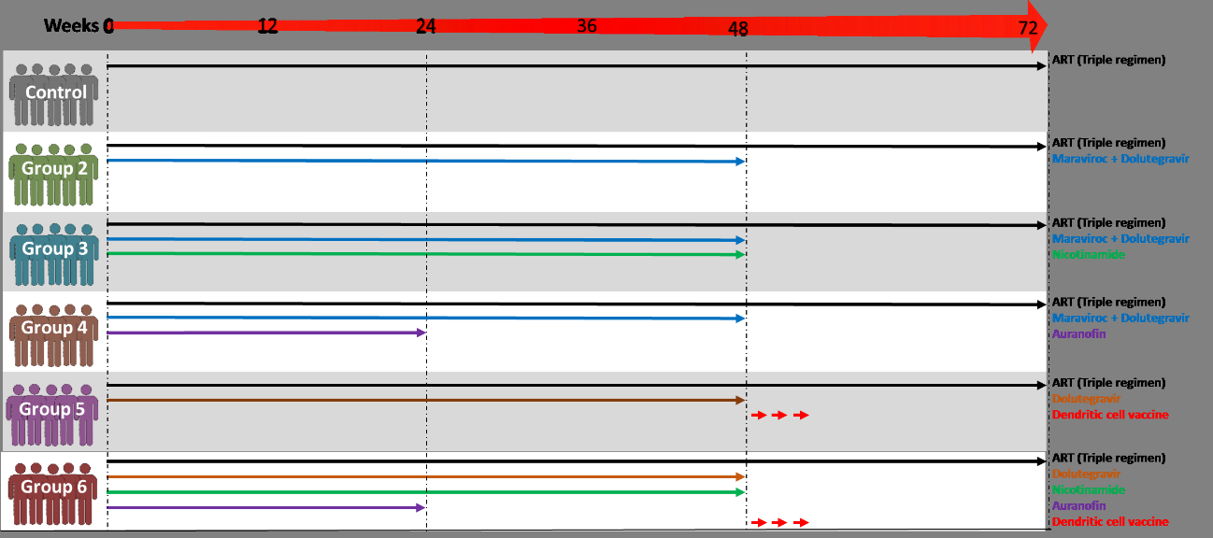
Auranofin plus Nicotinamide impact HIV reservoir among ART suppressed HIV individuals (WEPDB0105) Ricardo Sobhie Diaz; Federal University of Sao Paulo, Brazil
Residual HIV replication + virus/cell latency + viral sanctuaries
Pilot, proof of concept open label randomized clinical trial (NCT02961829)
30 patients allocated in 6 groups

Slide 2
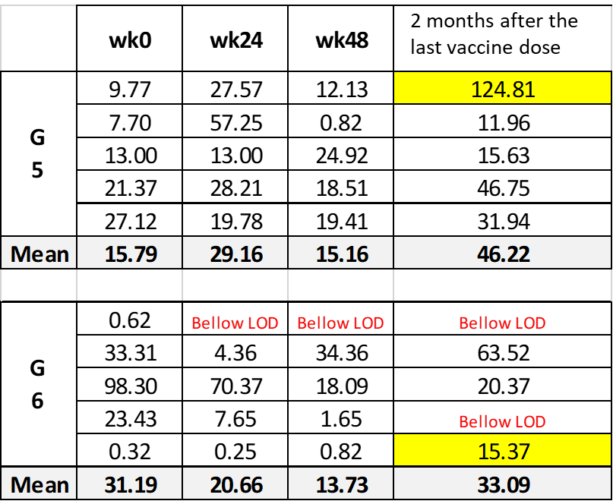
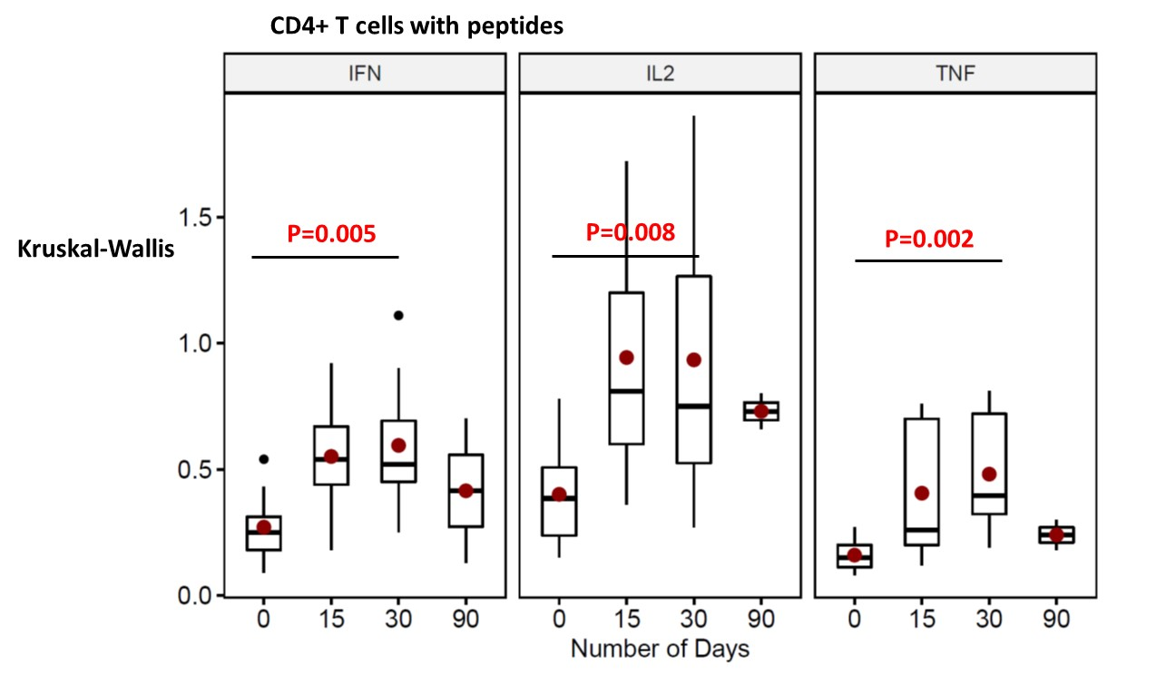
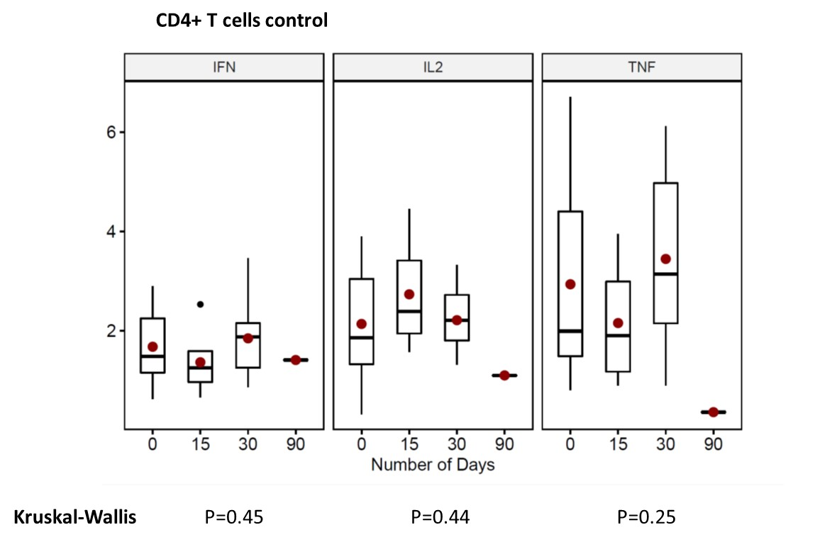
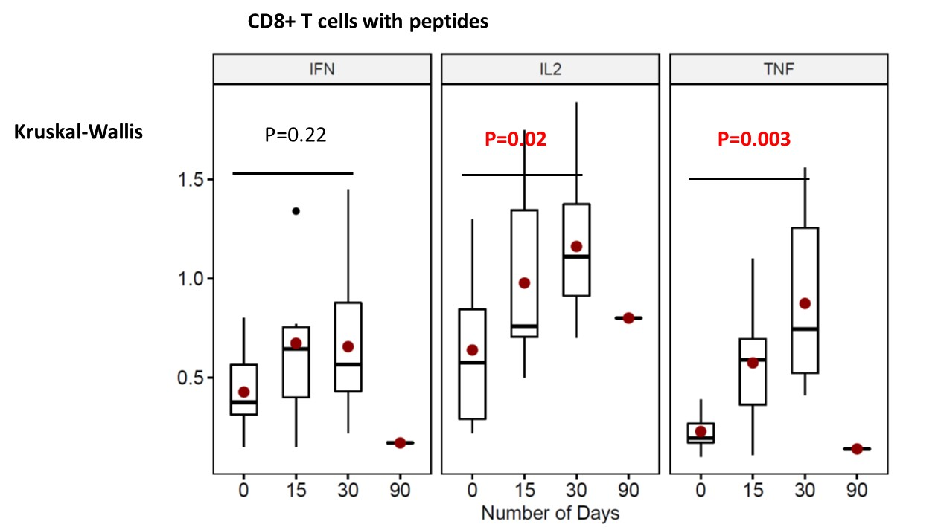
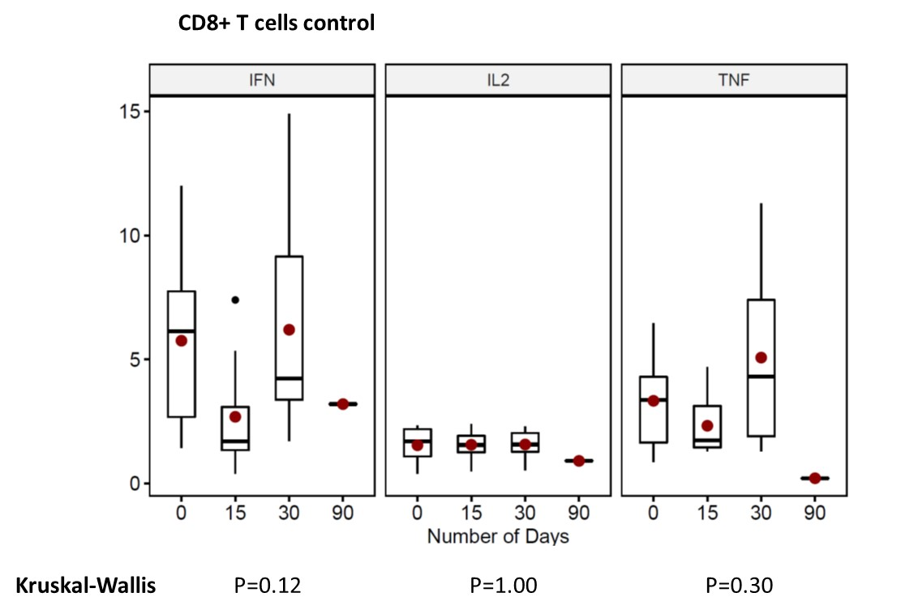
Results:
Cell activation markers: white bars = baseline; green bars = week 20.
% of CD4+ T cells CD38+, and CD8+ T cells and CD38+ in G6
Proviral HIV DNA over time
Levels of proviral DNA quantitation at PBMCs in G5 and G6.

Slide 3
Results (ctd):
Interventions were safe with no major AE
transient decreases in CD4 counts at weeks 8 and 12 in auranofin groups.
Decrease in Ab quantitation over time in G1-5.
None of the patients negativated Proviral HIV DNA at rectal biopsies. Correlation between of HIV proviral DNA quantitation at PBMCs and at rectal tissues at baseline but not at the end of study.
Conclusions/Discussion:
Auranofin and nicotinamide (NA) significantly decrease viral DNA in intensified ART-treated individuals, with one individual evolving with undetectable levels of HIV proviral DNA in PBMCs.
There was a decrease in the micro-inflammation levels in the auranofin and NA and ART intensification group (G6) as suggested by the activation markers in the CD4+ and CD8+ T cells.
After Autologous Dendritic cell vaccination one individual from G6 also evolved to undetectable levels of HIV proviral DNA in PBMCs.
Auranofin and nicotinamide administration in combination with intensified ART was well tolerated and safe.

